Slide 1

Welcome to the Quiz game application
It has three parts added to the game
Short, medium and long question
Gives you a score every at the end

Slide 2
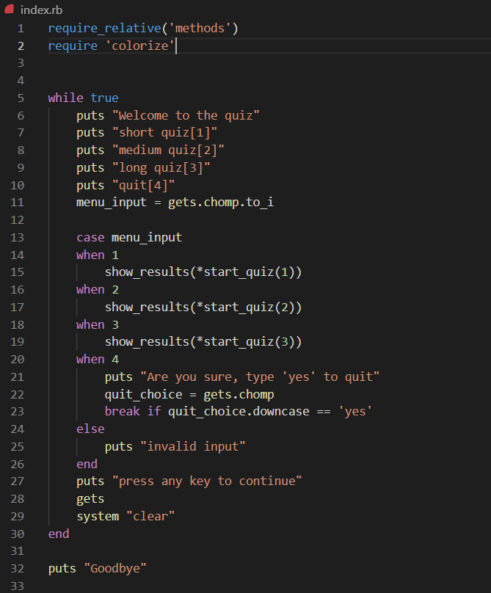

Slide 3
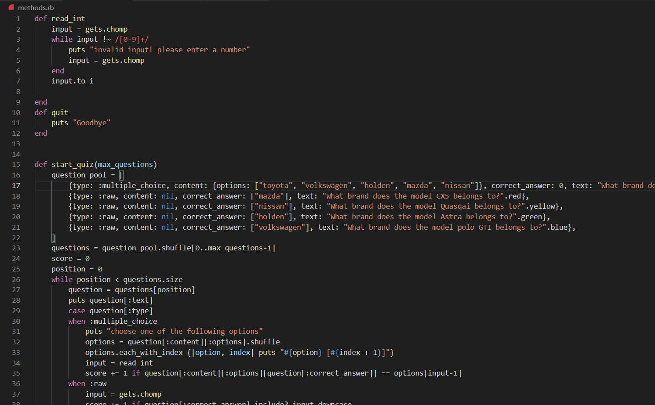

Slide 4
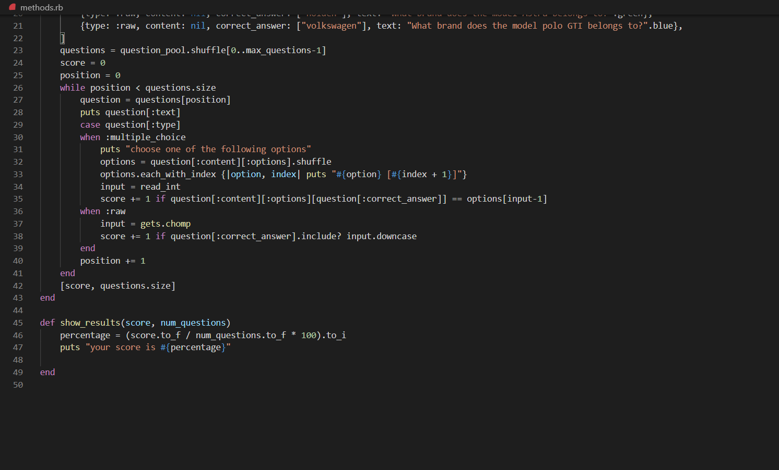

Slide 5
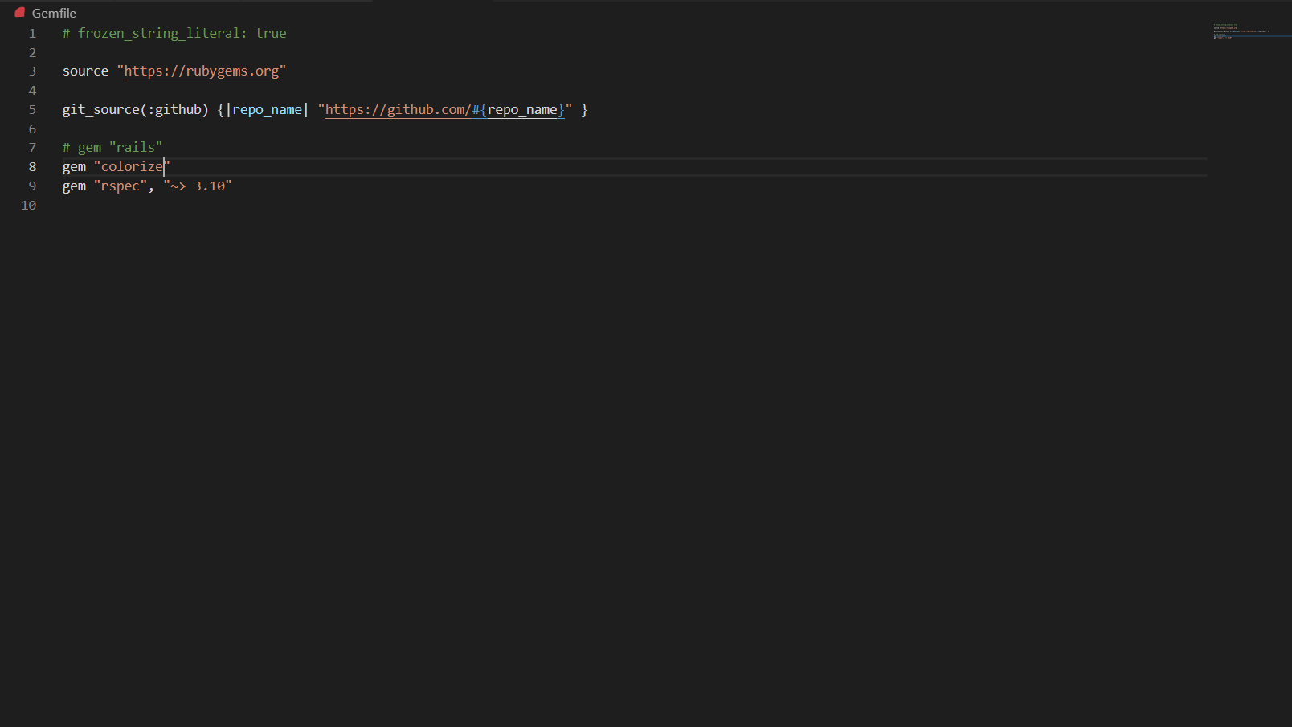

Slide 6
